Slide 1
ERP Implementation for badri rai Construction Limited (BRC Limited)
soul - a kiit company
DECEMBER 2021

Slide 2
About SOul - a kiit company
KIIT is comitted to high quality research and provides outstanding facilities and a supportive environment.
KIIT’s research portfolio extends across many different areas including, but not limited to, biotechnology, medicine; rural management; physical activity and nutrition; education; and social and mental health.
SOUL will leverage these skillsets and research outcomes to build world class products and services for its distinguished clients.
90+
projects
1921+
publications
2500
Researchers
30K
students

Slide 3
OUR COMPETENCY AREAS
1
Digital transformation – digital strategies and implementation support for enabling your business with latest technologies such as ERP, IOT, AI, ML and other new age information technology solutions
2
Organization and human development – helping you design and implement enabling structures and operating models for the new age workforce with focus on professional and personal growth
3
Policy, regulatory and governance – supporting you on advocating for and responding to, requisite policy, regulatory and governance needs, internally and externally, for growth and sustenance of your business
4
Finance function effectiveness – supporting your finance and accounts management business processes to become more lean and efficient and responsive to the evolving statutory and regulatory requirements
5
Engineering and technical – supporting your infrastructure design and development requirements with the best-in-class ideas and proof of concepts
6
Programme and project management – supporting you in planning, directing, coordinating, reviewing and monitoring of large programmes / projects, involving multiple stakeholders and / or multiple executing agencies

Slide 4
our understanding of THE requirement

Slide 5
High Level CONTEXT
BRC LIMITED headquartered in Noida would like to implement an system for their construction site in Assam.
Soul Limited would like to demonstrate existing capability in ERP area and decide on the next steps.

Slide 6
our understanding of construction INDUSTRY PROCESSES
Initiation : Presales, Bidding, Tender, Contract ,Legal ,Plan Approval, Design
Execution : Operation management, Project Handling ,Procurements
Monitoring : Quality control, Vendor and Sub contractor management
Closure/Delivery/Registration : Project closure and Accounting, Compliance management
IT/Product Support : ERP implementation and post roll out support, Reporting

Slide 7
process areas that needs erp intervention
Finance management : Online Payment, Account management.
Asset Management : Asset tracking, Material management, Procurement management, Energy and Pollution monitoring, Asset movement
Workforce Management : Sub contractor management, Vendor Management, Labour management, Project planning and execution and monitoring
IT support : Engineering Design digitization, Online bidding and compliance management.

Slide 8
what makes it stands apart from other products
ERP is a full-featured web based business management solution to record all business transactions in a product suite.
It supports out of box multi-country, multi-company, multi-currency capabilities.
It has low code support to support business processes and provides ease of customization for handling complex business scenarios.

Slide 9
REQUIREMENTS UNDERSTANDING(HIGH LEVEL)
Customer Required Software Domain | ERP Existing Domain Mapping
Finance & Accounting | PAYROLL,ACCOUNTING
Purchase & Inventory | BUY,STOCK
Project Management System | New Development
Document Management System | New Development
Estimation, Bidding & Tendering | New Development
Fixed Assets & Maintenance (Tools & Plants) | ASSET,New Development
Engineering | STOCK

Slide 10
Commercials
SI NO | Cost Code | Tentative Cost (in Crores Cr)
1 | Total Software Development Cost Due Dilligence/Assesment Customization EFFORT Cost Requirement Gathering Validation POC Roll out to Site and User Training | 1.60 Cr
2 | Support Cost (AMC excluding Software License) | 30% of Total Annually
3 | Software License Cost (Tentative discount and vendor license discussion pending) | 15 lakhs annaually
 | Change Request Cost | 9600/day
4 | Travel Cost | As per actual to Customer Site

Slide 11
ASSUMPTIONS
Client will be providing infrastructrure for hosting the software.In case Soul has to setup same it may increase the cost.
Availability of customer SME during all the phases of lifecycle especially full access during Due Dilliegence and POC phase.
The cost is tentative and will be firmed up based on discussion with SME duing due dilgence phase and scope finalization.
The payment terms is not finalized and may need further negotiation between Soul and BRC.
AMC includes support services in remote mode.In case presence at customer site is required it will be charged at actual travel cost as described in Cost Requirements.
The system will be deployed in single-tenancy environment at customer preferred location in Assam.

Slide 12
our Delivery methodology

Slide 13
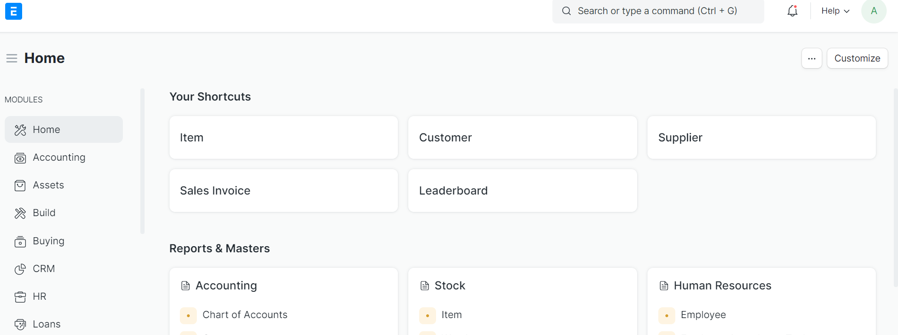

OUr Approach to Agile Execution
From ideation...
Enablers
Entry | Task | Deliverable
GO Live | Production Move | Change Management Support
1.
DEFINE
ERPNEXT Product Experience
Entry | Task | Deliverable
Goal Vision | Presales, High level demo | Vision/Mission Statement
Problem statement
Customer focused Delivery Excellence
Enterprise Architecture
POC
Iterative Process
CX Lab
5.
REFRESH
Iterative process
ERPNEXT Delivery
Team
Entry | Task | Deliverable
Due Diligence | POC Customer Design thinking session | Project Plan Size, Commercial EPIC/Backlog
1.
DEFINE
2.
PROTOTYPE
Continuous innovations
Continuous innovations
...to industrialisation
Goals
4.
DEPLOY
Vision
5.
REFRESH
Train
Entry | Task | Deliverable
UAT | UAT | Approval/ Rework
Track value
Entry | Task | Deliverable
Customization | Development Data Migration Testing | Beta Release
Change management
3.
EXPAND
...to Go Live/Support

Slide 14
a tentative implementation plan
Define - Due Dilligence
Prototype
Deploy
x weeks
x weeks
x week
Define - Process Map
Expand
Refresh
x months
x weeks + 3 years support
x weeks

Slide 15
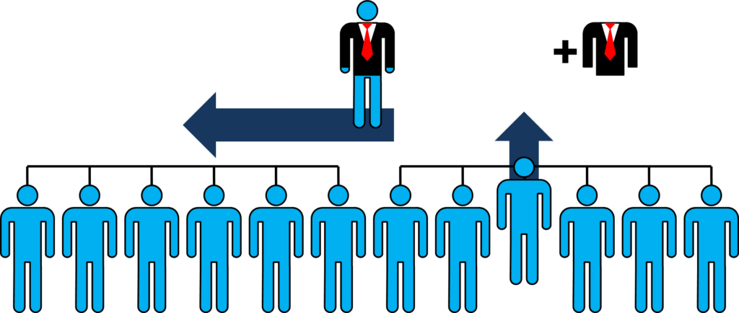
a tentative STEADY STATE plan
Warranty Period
Support Period
Break Fix
Simple Changes
Change Request
3 years
Request For Application Change Received
Severity and Impact and Financial Analysis
Development & Testing & Deployment
New Version Released
Remote Support
Core Support team at Bhubaneswar

Slide 16

Question
Thank You

Slide 17




SOUL Serving the society with meaningful and sustainable solutions
Reg. Off.: Campus No. 2, Plot No. 384/2165, 383, Patia, Chandaka Industrial Estate, Bhubaneswar - 751024 | Corporate Office: Ground Floor, New Block, Campus-1,KIIT, Bhubaneswar - 751024
+91 (0) 70777 69334
soul@soulunileaders.com

